Slide 1
Cooperating Intelligent Systems
Intelligent Agents
Chapter 2, AIMA

Slide 2
An agent
Image borrowed from W. H. Hsu, KSU
An agent perceives its environment through sensors and acts upon that environment through actuators.
Percepts x
Actions α
Agent function f
Percepts
Sensors
?
Environment
Agent
Actions
Effectors

Slide 3
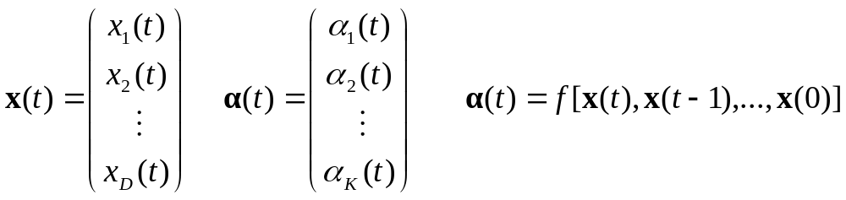
An agent
Image borrowed from W. H. Hsu, KSU
An agent perceives its environment through sensors and acts upon that environment through actuators.
Percepts x
Actions α
Agent function f
Percepts
Sensors
?
Environment
Agent
Actions
Effectors
”Percept sequence”

Slide 4
Example: Vacuum cleaner world
Image borrowed from V. Pavlovic, Rutgers
A
B
Percepts: x₁(t) ∈ {A, B}, x₂(t) ∈ {clean, dirty}
Actions: α₁(t) = suck, α₂(t) = right, a₃(t) = left

Slide 5
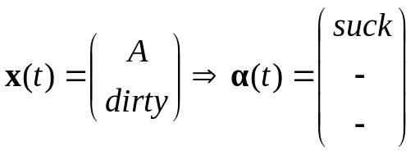
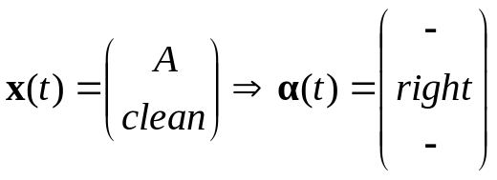
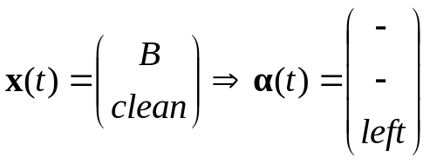
Example: Vacuum cleaner world
Image borrowed from V. Pavlovic, Rutgers
A
B
Percepts: x₁(t) ∈ {A, B}, x₂(t) ∈ {clean, dirty}
Actions: α₁(t) = suck, α₂(t) = right, a₃(t) = left
This is an example of a reflex agent

Slide 6
A rational agent
A rational agent does ”the right thing”:
For each possible percept sequence, x(t)...x(0),
should a rational agent select the action that
is expected to maximize its performance
measure, given the evidence provided by the
percept sequence and whatever built-in
knowledge the agent has.
We design the performance measure, S

Slide 7
Rationality
Rationality ≠ omniscience
  Rational decision depends on the agent’s experiences in the past (up to now), not expected experiences in the future or others’ experiences (unknown to the agent).
  Rationality means optimizing expected performance, omniscience is perfect knowledge.

Slide 8
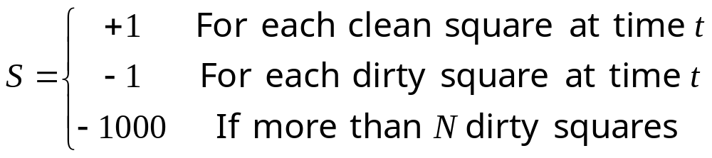
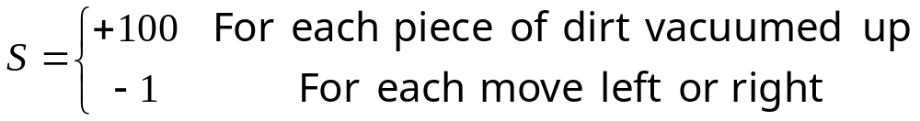
Vacuum cleaner world performance measure
Image borrowed from V. Pavlovic, Rutgers
A
B
State defined
perf. measure
Does not
really lead
to good
behavior
Action defined
perf. measure

Slide 9
Task environment
Task environment = problem to which the agent is a solution.
P | Performance measure | Maximize number of clean cells & minimize number of dirty cells.
E | Environment | Discrete cells that are either dirty or clean. Partially observable environment, static, deterministic, and sequential. Single agent environment.
A | Actuators | Mouthpiece for sucking dirt. Engine & wheels for moving.
S | Sensors | Dirt sensor & position sensor.

Slide 10
Some basic agents
Random agent
Reflex agent
Model-based agent
Goal-based agent
Utility-based agent
Learning agents

Slide 11
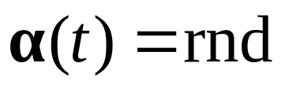
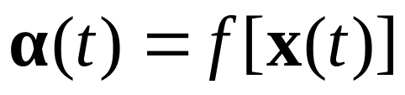
The random agent
The action α(t) is selected purely at random, without any consideration of the percept x(t)
Not very intelligent.
The reflex agent
The action α(t) is selected based on only the most recent percept x(t)
No consideration of percept history.
Can end up in infinite loops.

Slide 12
Simple Reflex Agent
sensors
What the world is like now
Environment
Condition - action rules
What action I should do now
effectors
function SIMPLE-REFLEX-AGENT(percept) returns action
static: rules, a set of condition-action rules
state ← INTERPRET-INPUT (percept)
rule ← RULE-MATCH (state,rules)
action ← RULE-ACTION [rule]
return action
First match.
No further matches sought.
Only one level of deduction.
A simple reflex agent works by finding a rule whose condition matches the current situation (as defined by the percept) and then doing the action associated with that rule.
Slide borrowed from Sandholm @ CMU

Slide 13
Simple reflex agent…
Table lookup of condition-action pairs defining all possible condition-action rules necessary to interact in an environment
  e.g. if car-in-front-is-breaking then initiate breaking
Problems
  Table is still too big to generate and to store (e.g. taxi)
  Takes long time to build the table
  No knowledge of non-perceptual parts of the current state
  Not adaptive to changes in the environment; requires entire table to be updated if changes occur
  Looping: Can’t make actions conditional
Slide borrowed from Sandholm @ CMU

Slide 14
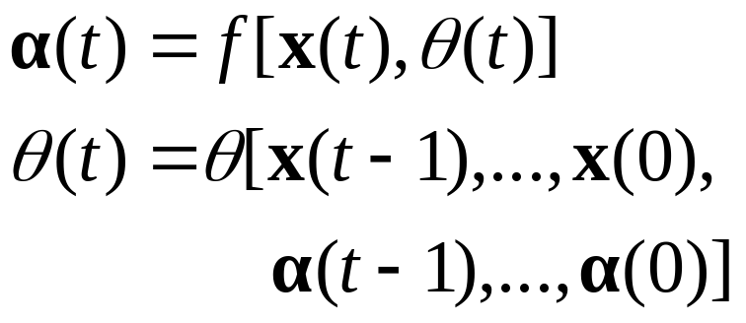
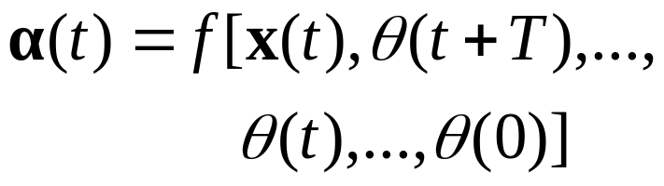
The model based agent
The action α(t) is selected based on the percept x(t) and the current state θ(t).
The state θ(t) keeps track of the past actions and the percept history.
The goal based agent
The action α(t) is selected based on the percept x(t), the current state θ(t), and the future expected set of states.
One or more of the states is the goal state.

Slide 15
Reflex agent with internal state
State
sensors
How the world evolves
What the world is like now
What my actions do
Environment
Condition - action rules
What action I should do now
effectors
Model based agent
Slide borrowed from Sandholm @ CMU

Slide 16
Agent with explicit goals
State
sensors
How the world evolves
What the world is like now
What my actions do
What it will be like if I do action A
Environment
Goals
What action I should do now
effectors
Goal based agent
Slide borrowed from Sandholm @ CMU

Slide 17
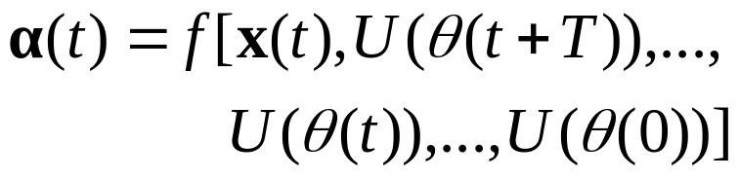
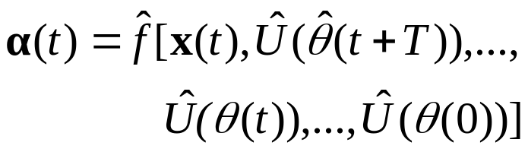
The utility based agent
The action α(t) is selected based on the percept x(t), and the utility of future, current, and past states θ(t).
The utility function U(θ(t)) expresses the benefit the agent has from being in state θ(t).
The learning agent
The learning agent is similar to the utility based agent. The difference is that the knowledge parts can now adapt (i.e. The prediction of future states, the utility, ...etc.)

Slide 18
Utility-based agent
State
sensors
How the world evolves
What the world is like now
What my actions do
What it will be like if I do action A
Environment
Utility
How happy I will be in such as a state
What action I should do now
effectors
Slide borrowed from Sandholm @ CMU

Slide 19
Discussion
Exercise 2.2:
Both the performance measure and the utility function measure how well an agent is doing. Explain the difference between the two.
They can be the same but do not have to be. The performance function is used externally to measure the agent’s performance. The utility function is used internally to measure (or estimate) the performance. There is always a performance function but not always an utility function.

Slide 20
Discussion
Exercise 2.2:
Both the performance measure and the utility function measure how well an agent is doing. Explain the difference between the two.
They can be the same but do not have to be. The performance function is used externally to measure the agent’s performance. The utility function is used internally (by the agent) to measure (or estimate) it’s performance. There is always a performance function but not always an utility function (cf. random agent).

